Slide 1
Linked List Questions

Slide 2
Reverse a Linked List
Problem Statement: Given the head of a singly linked list, write a program to reverse the linked list, and return the head pointer to the reversed list.
Input Format: head = [3,6,8,10]
This means the given linked list is 3->6->8->10 with head pointer at node 3.
Result: Output = [10,6,8,3]

Slide 3
Find middle element in a Linked List
Problem Statement: Given the head of a singly linked list, return the middle node of the linked list. If there are two middle nodes, return the second middle node.
Input Format: ( Pointer / Access to the head of a Linked list ) head = [1,2,3,4,5]
Result: [3,4,5]
Input Format: Input: head = [1,2,3,4,5,6]
Result: [4,5,6]

Slide 4
Add two numbers represented as Linked Lists
Problem Statement: Given the heads of two non-empty linked lists representing two non-negative integers. The digits are stored in reverse order, and each of their nodes contains a single digit. Add the two numbers and return the sum as a linked list.
Input Format: (Pointer/Access to the head of the two linked lists)
num1 = 342, num2 = 564
l1 = [2,4,3] l2 = [5,6,4]
Result: sum = 807; L = [7,0,8]
Input Format: (Pointer/Access to the head of the two linked lists) l1 = [9,9,9,9,9,9,9], l2 = [9,9,9,9]
Result: [8,9,9,9,0,0,0,1]

Slide 5
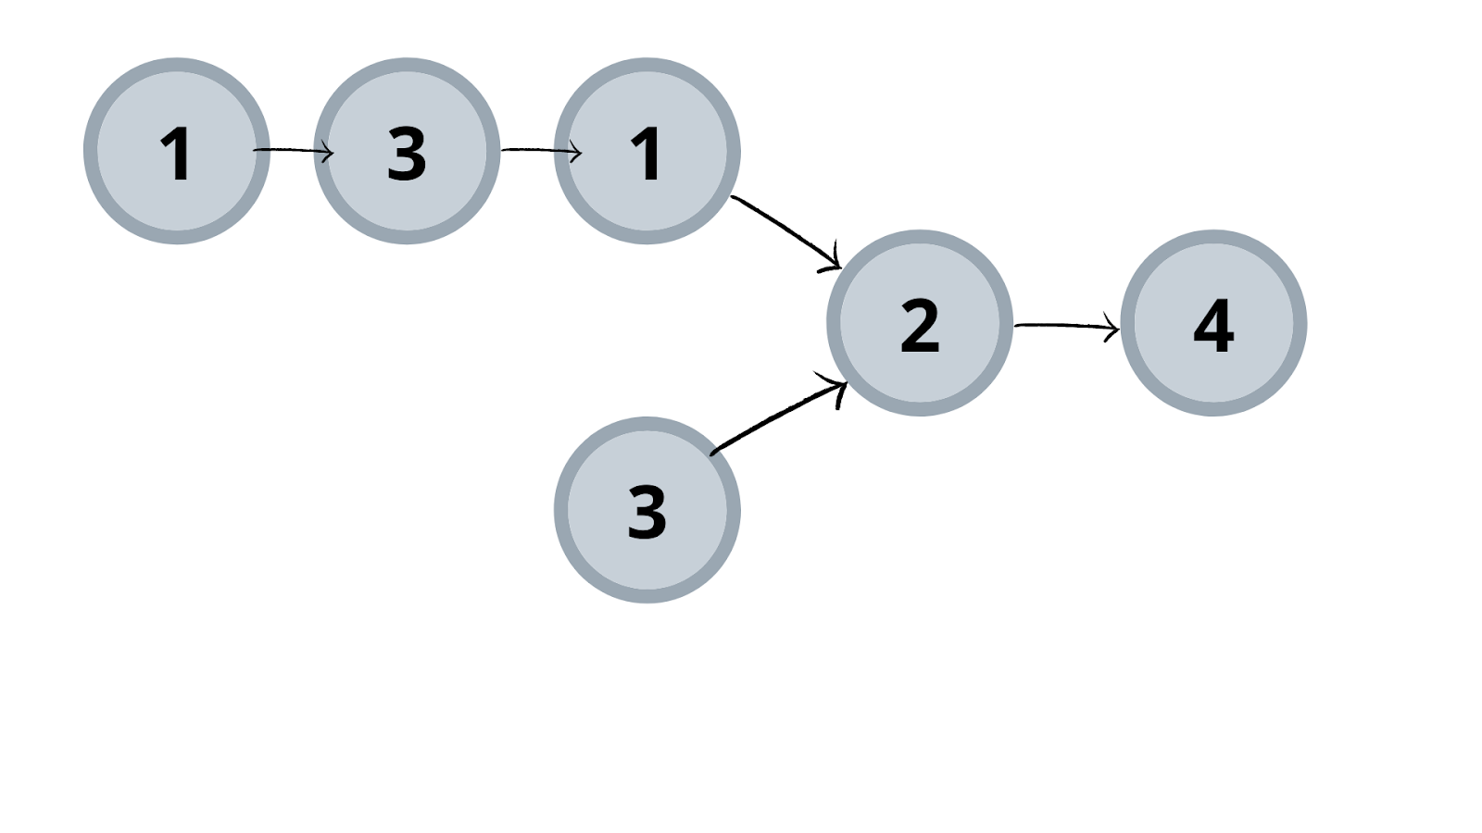
Find intersection of Two Linked Lists
Problem Statement: Given the heads of two singly linked-lists headA and headB, return the node at which the two lists intersect. If the two linked lists have no intersection at all, return null.
Example 1: Input: List 1 = [1,3,1,2,4], List 2 = [3,2,4] Output: 2

Slide 6
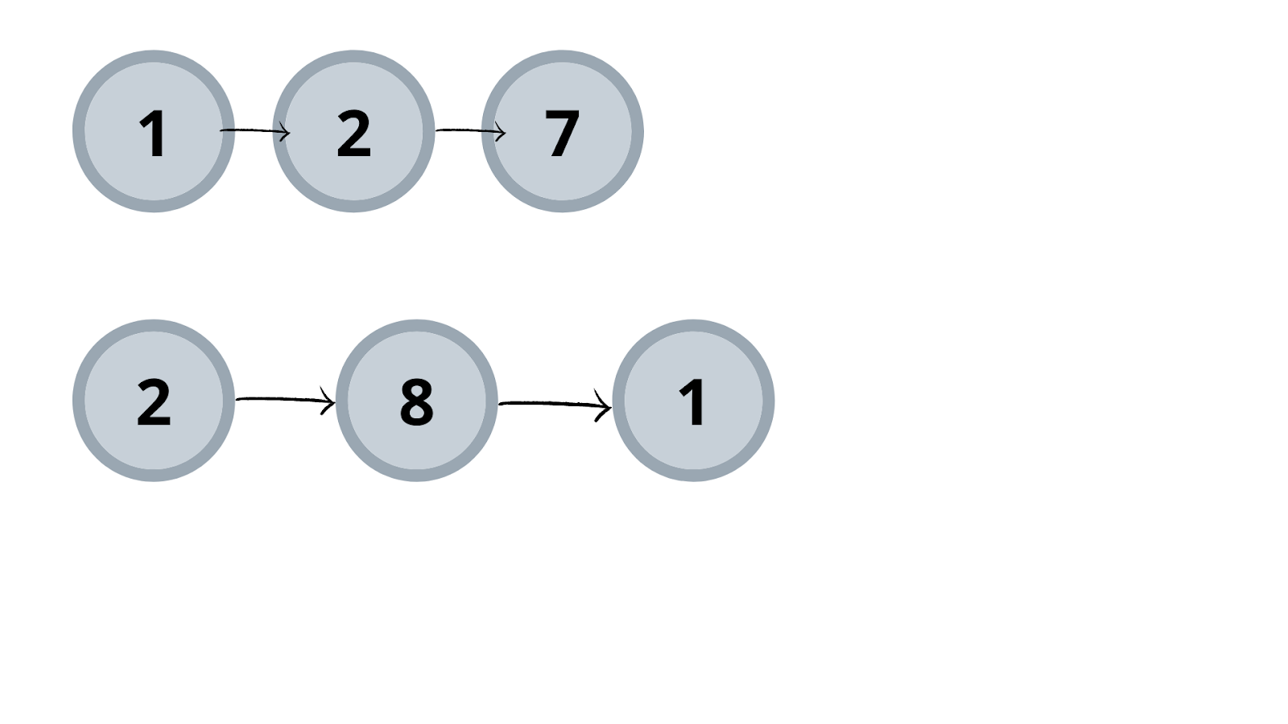
Example 2: Input: List1 = [1,2,7], List 2 = [2,8,1] Output: Null

Slide 7
Detect a Cycle in a Linked List
Problem Statement: Given head, the head of a linked list, determine if the linked list has a cycle in it. There is a cycle in a linked list if there is some node in the list that can be reached again by continuously following the next pointer.
Return true if there is a cycle in the linked list. Otherwise, return false.

Slide 8
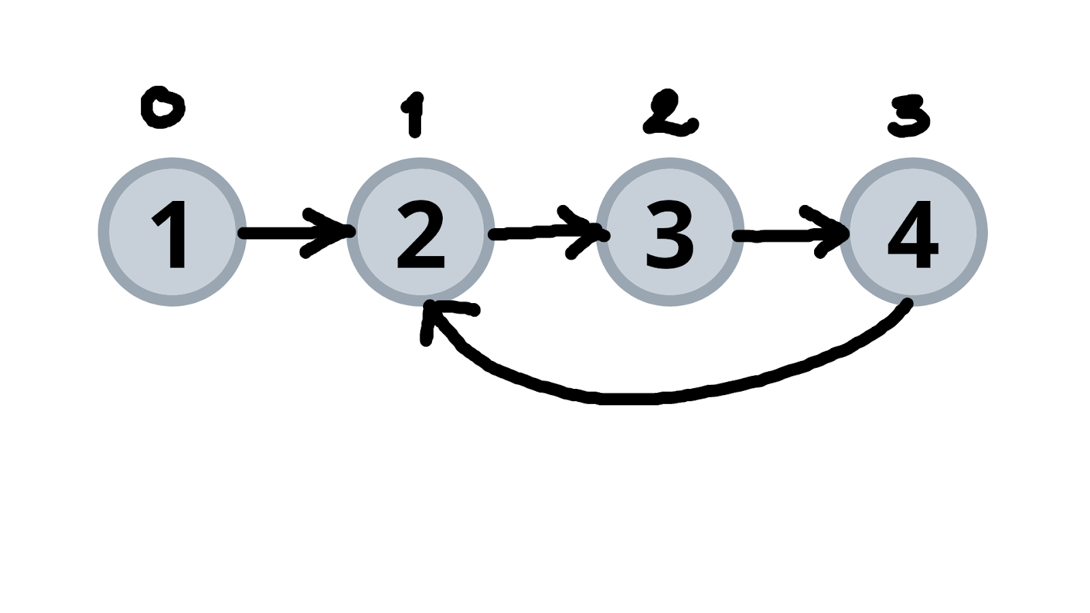
Example 1: Input: Head = [1,2,3,4]
Output: true Explanation: Here, we can see that we can reach node at position 1 again by following the next pointer. Thus, we return true for this case.

Slide 9
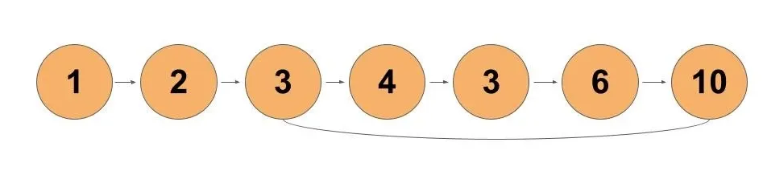
Starting point of loop in a Linked List
Problem Statement: Given the head of a linked list, return the node where the cycle begins. If there is no cycle, return null.
Example 1: Input: head = [1,2,3,4,3,6,10] Output: tail connects to node index 2

Slide 10
Rotate a Linked List
Problem Statement: Given the head of a linked list, rotate the list to the right by k places.
Example 1: Input: head = [1,2,3,4,5] k = 2
Output: head = [4,5,1,2,3]

